Slide 1
ORM

Slide 2
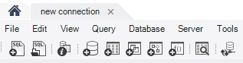
How to create a database
Open Workbench
Click on “create a new schema…”

Slide 3
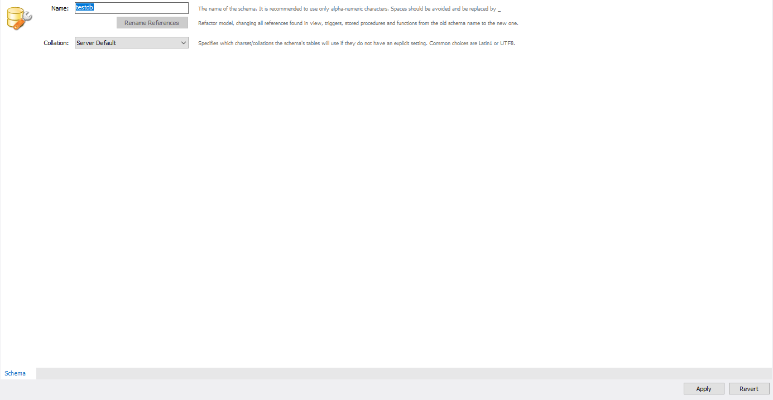
How to create a database
Add a database name and then click on Apply

Slide 4
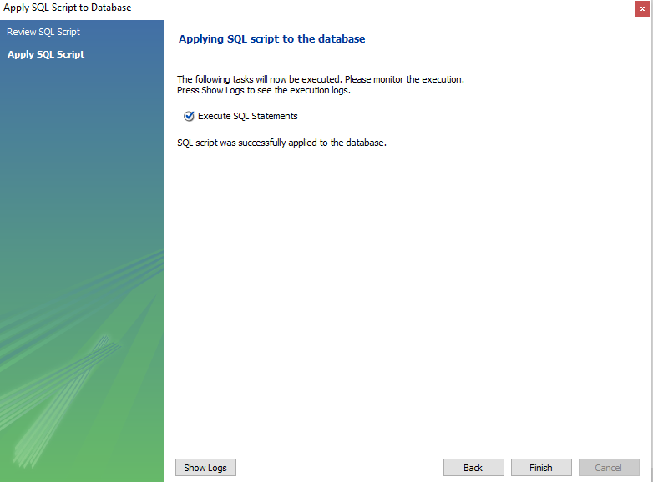
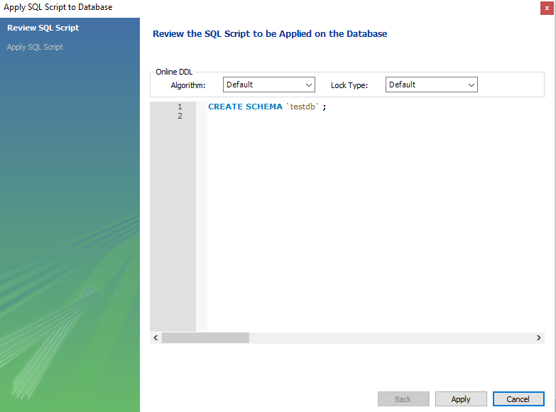
How to create a database
Click on Apply button, then on Finish button.

Slide 5
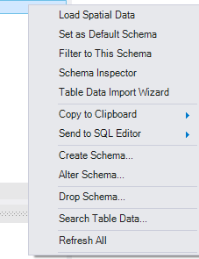
How to create a database
Right click on your database, then click on Set as Default Schema.

Slide 6
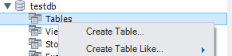
How to create a table
Right click on Tables and then click on Create Table

Slide 7
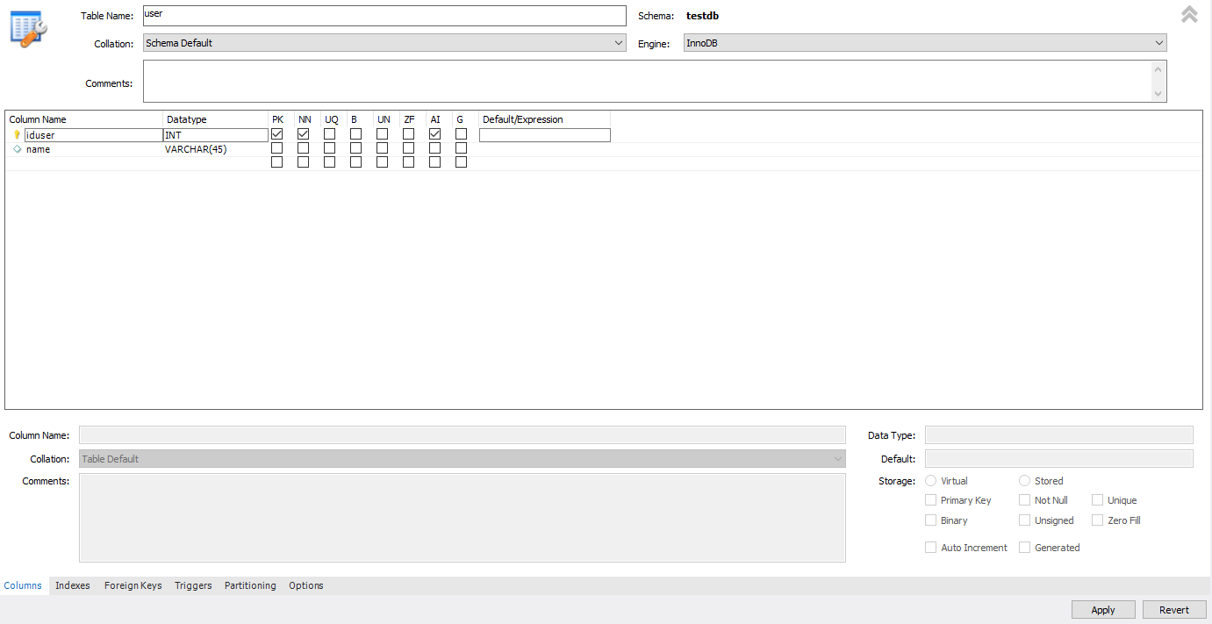
How to create a table
Add a table name, the columns’ names and chose the proper Datatype. Check AI( auto incremental for the primary key). Click on the Apply button(2x) and then click on the Finish button.

Slide 8
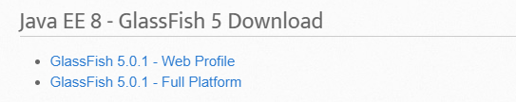
How to install GlassFish
Go to https://javaee.github.io/glassfish/download
Chose GlassFish 5.0.1 – Full Platform, download it and unzip it on your machine.

Slide 9
How to install GlassFish
Download Eclipse EE from here https://www.eclipse.org/downloads/packages/release/2019-03/r/eclipse-ide-enterprise-java-developers
Install Eclipse IDE for Enterprise Java Developers

Slide 10
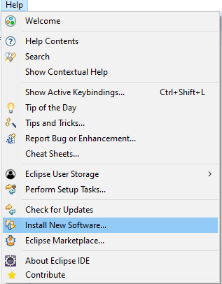
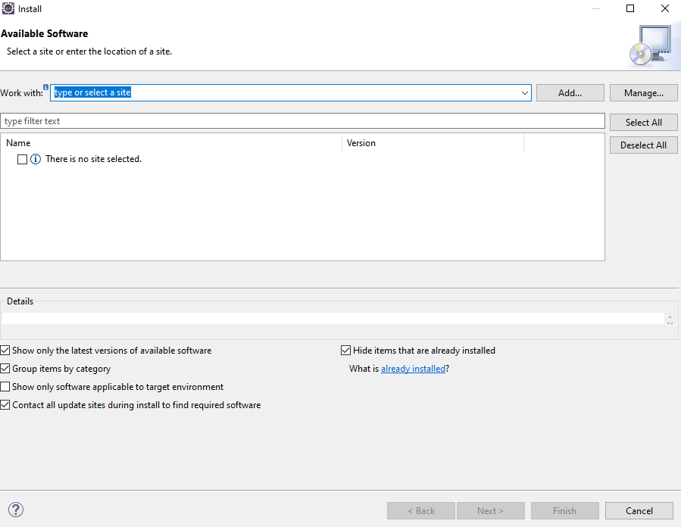
How to install GlassFish tools
Go to Help -> Install New Software… -> Add

Slide 11
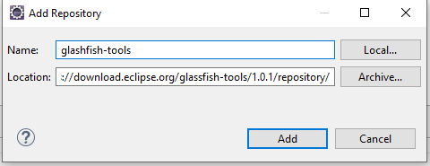
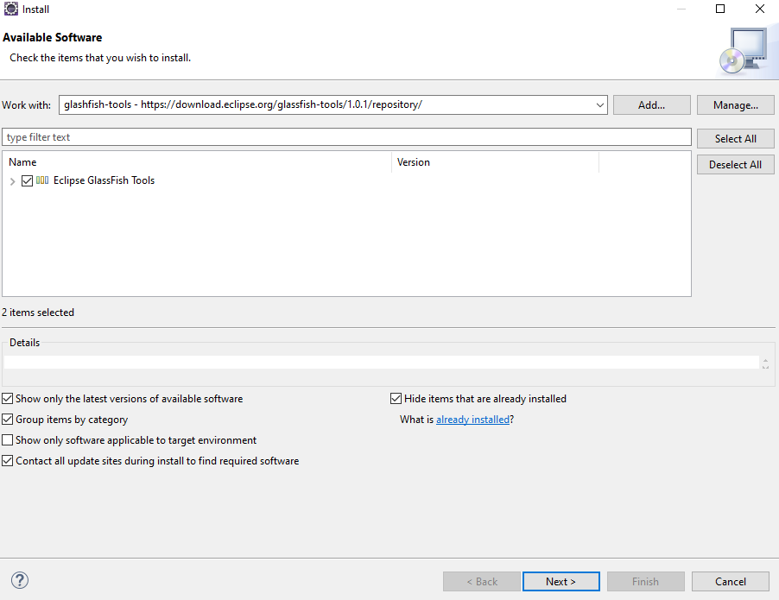
How to install GlassFish tools
Add a name then on the location box add this link: https://download.eclipse.org/glassfish-tools/1.0.1/repository/
Click on Add button, then click on Next button

Slide 12
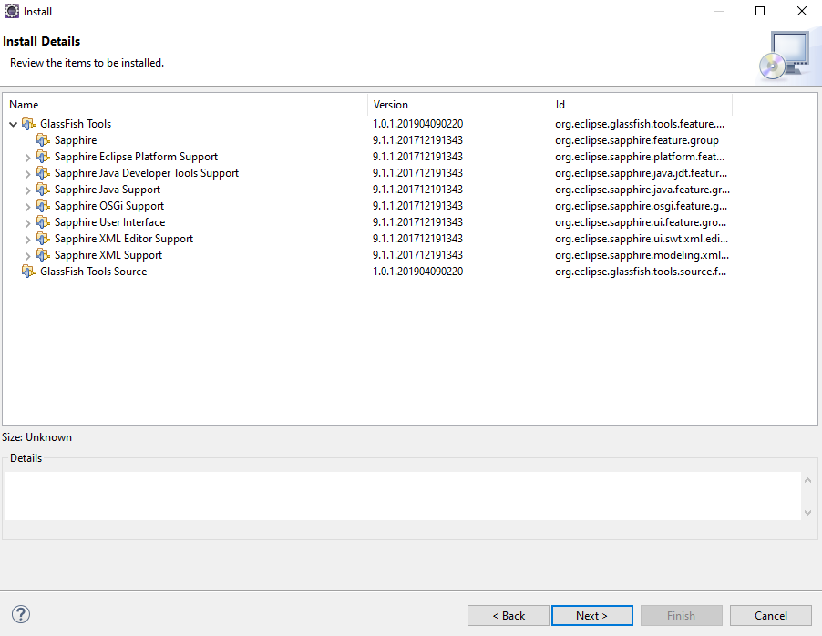
How to install GlassFish tools
Click on Next button, then on Finish button.
Restart the eclipse when is requested

Slide 13
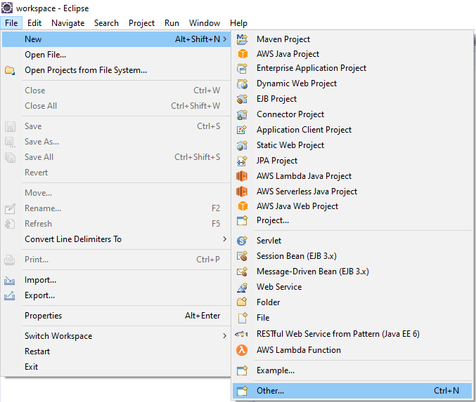
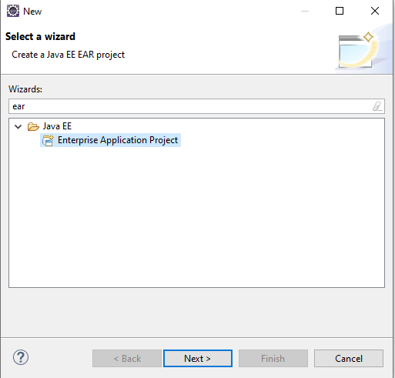
How to create an EAR Project
Go to File -> New -> Other… -> Enterprise Application Project -> Next

Slide 14
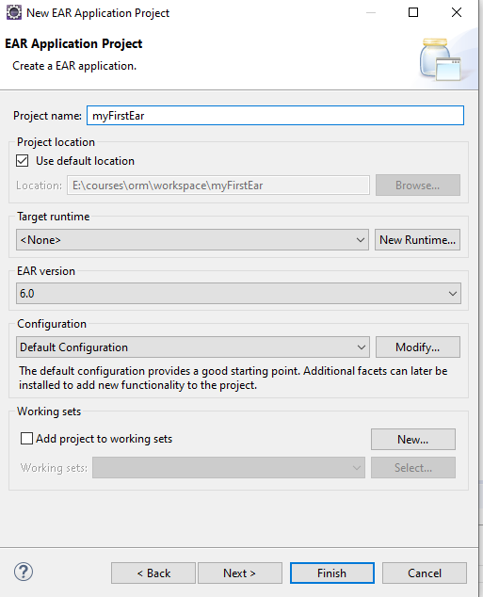
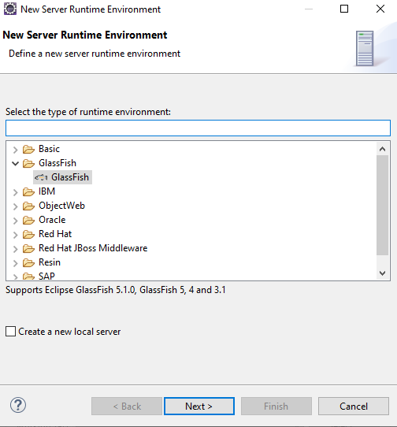
How to create an EAR Project
Add a project name, then click on New Runtime…, chose GlassFish, accept the terms of the license agreement.

Slide 15
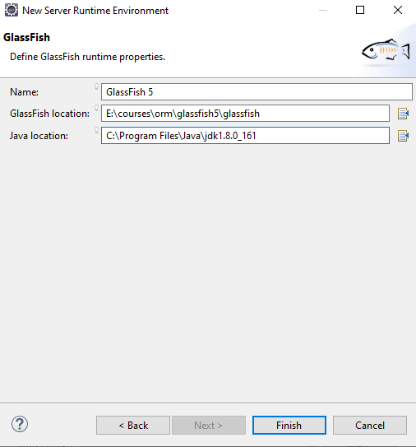
How to create an EAR Project
Add the GlassFish and Java location, then click on Finish button.

Slide 16
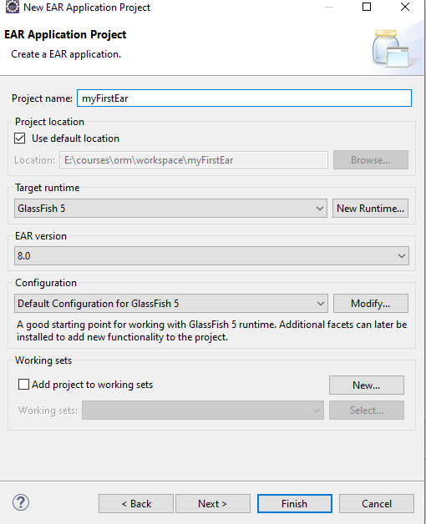
How to create an EAR Project
You should see something like this

Slide 17
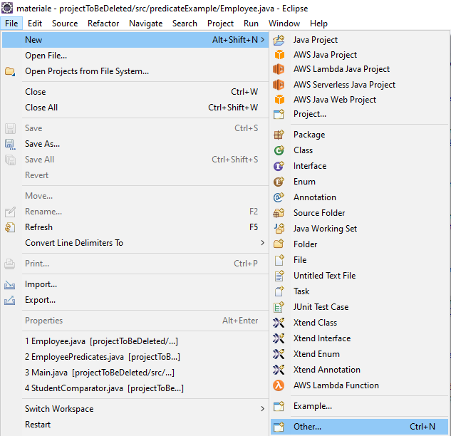
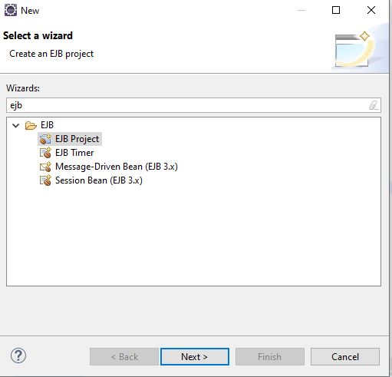
How to create an EJB Project
Go to New -> Other… - > EJB Project -> Next

Slide 18
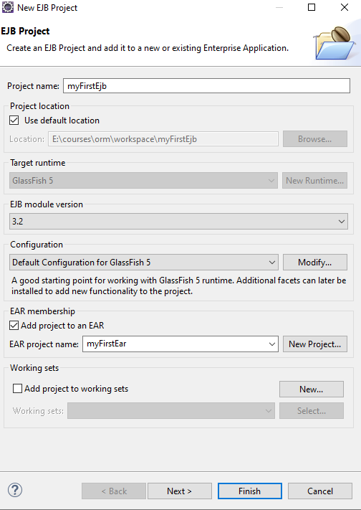
How to create an EJB Project
Check Add project to an EAR, then click on Finish button

Slide 19
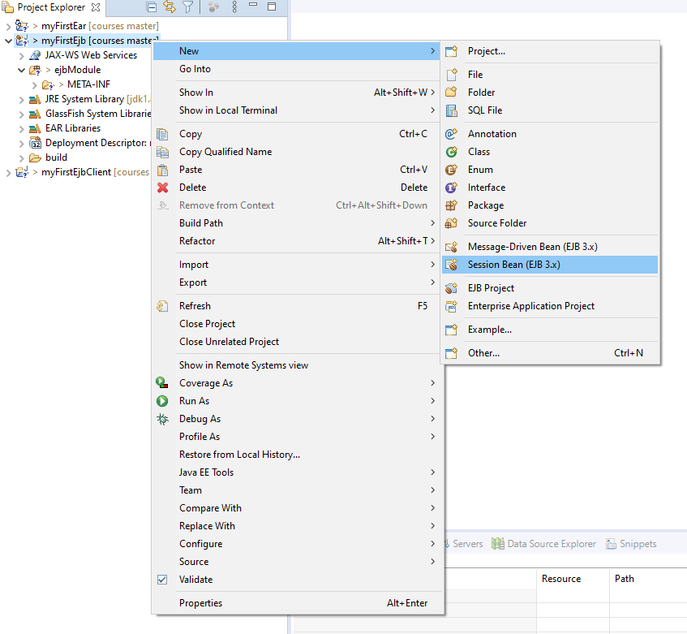
How to create an EJB Project
Right click on the EJB project -> New -> Session Bean

Slide 20
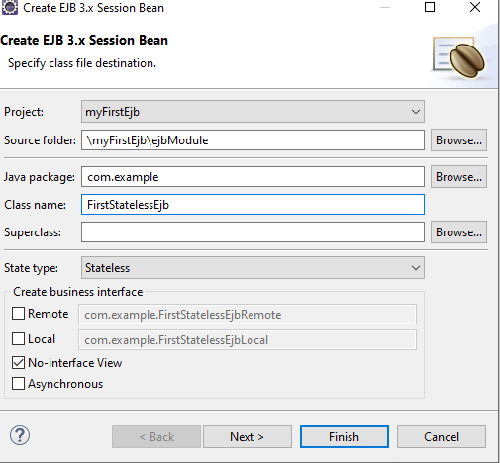
How to create an EJB Project
Add you java package name and a class name, then click on Finish button.

Slide 21
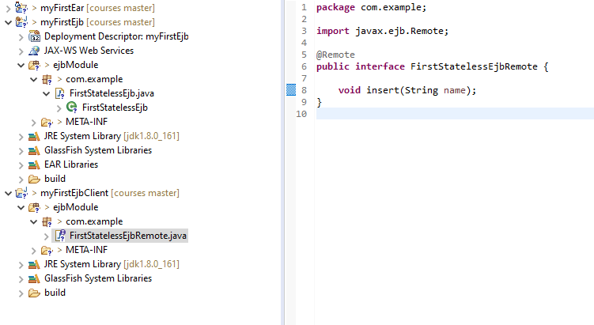
How to create an EJB Project
In myFirstEjbClient add the package com.example, then add an interface named FirstStatelessEjbRemote with an insert method inside.

Slide 22
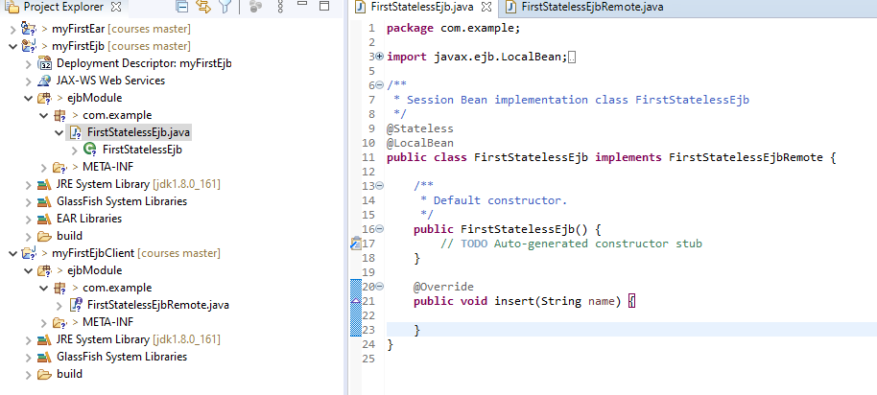
How to create an EJB Project
Modify in myFirstEjb project the class FirstStatelessEjb like this:

Slide 23
How to create an EJB Project
Copy C:\Program Files (x86)\MySQL\Connector.J 5.1\mysql-connector-java-5.1.44-bin.jar to yourGlassfishLocation\glassfish5\glassfish\lib\

Slide 24
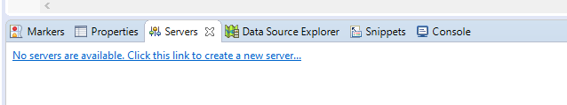
How to configure a server
Click on “No serves are available… “

Slide 25
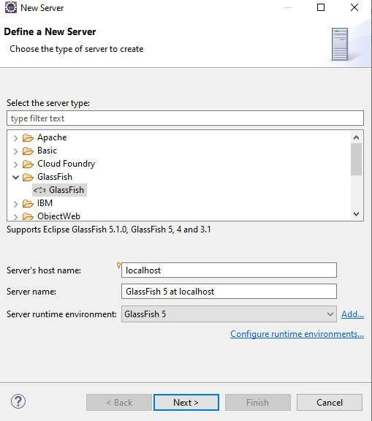
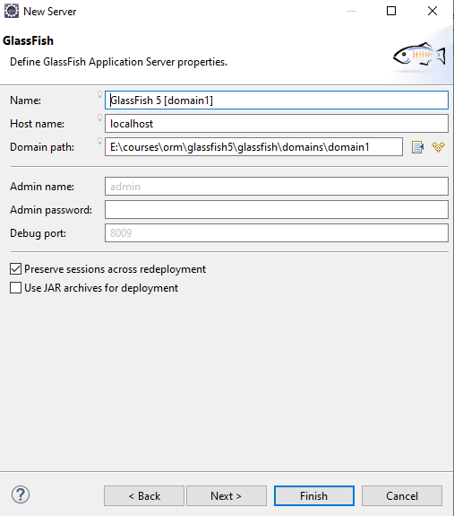
How to configure a server
Chose GlassFish, click on Next button, then click on Next button.

Slide 26
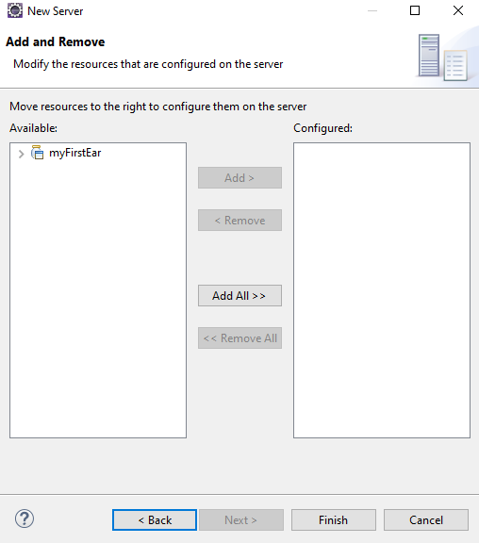
How to configure a server
Click on Add All, then click Finish button.

Slide 27
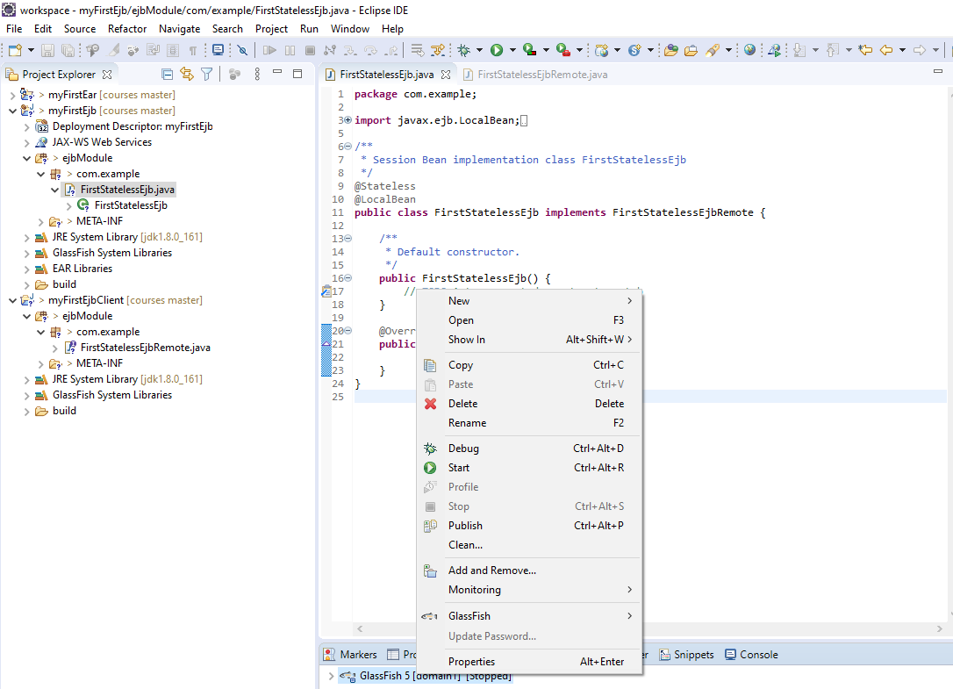
How to start a server
Right click on the GlassFish, then click on Start button.

Slide 28
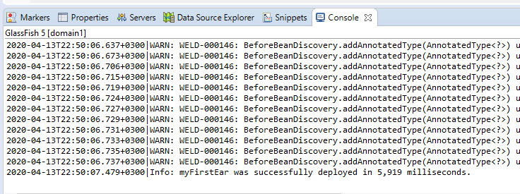
How to start a server
If everything is ok you should see something like this:

Slide 29
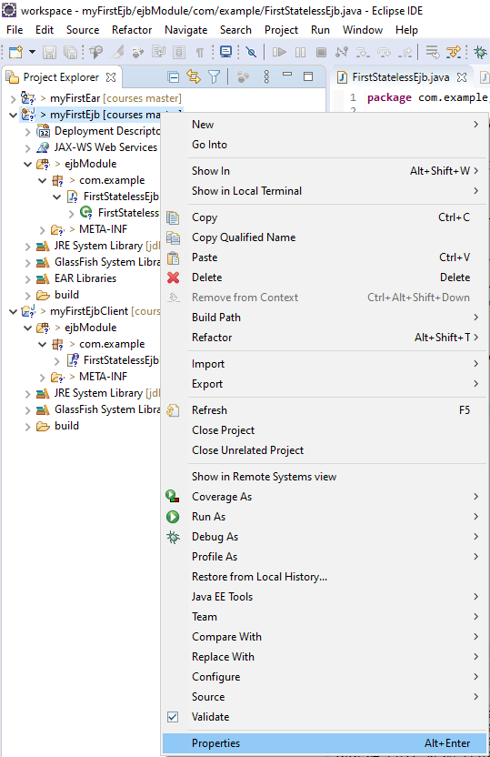
How to add Project Facets
Click on the ejb project, then click on Properties.

Slide 30
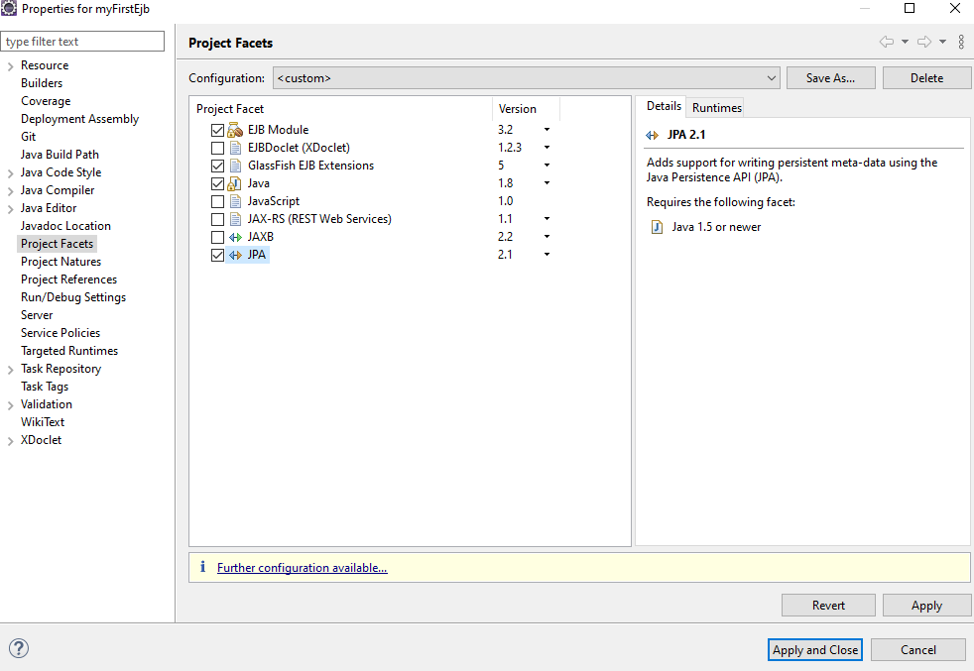
How to add Project Facets
Chose Project Facets, check JPA and chose version 2.1. Click on Further configuration available…

Slide 31
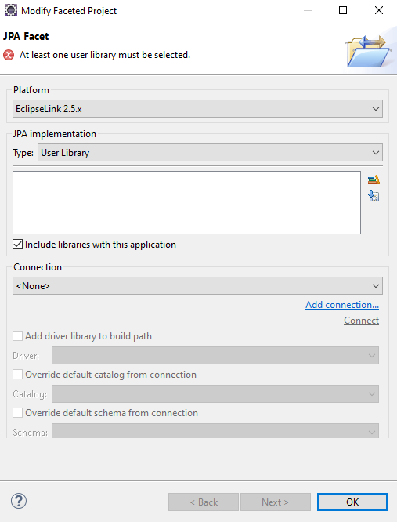
How to add Project Facets
Chose Eclipse Link 2.5, then click on Add Library.

Slide 32
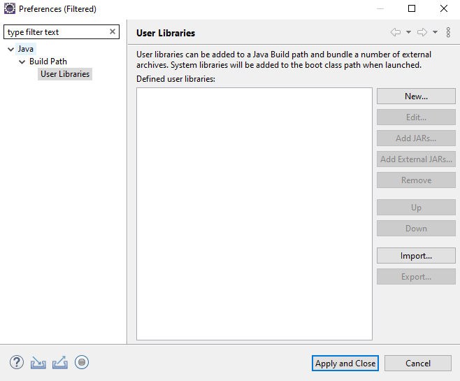
How to add Project Facets
Click on New button.

Slide 33
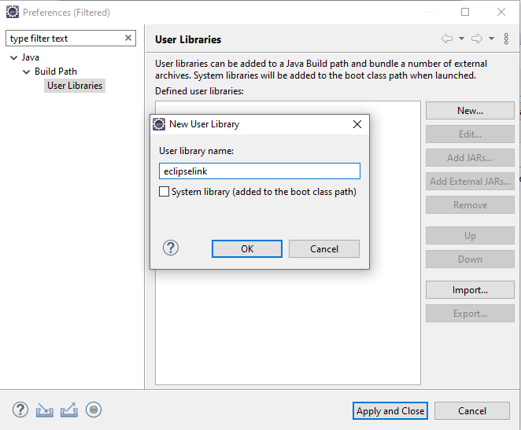
How to add Project Facets
Add the name of the library.

Slide 34
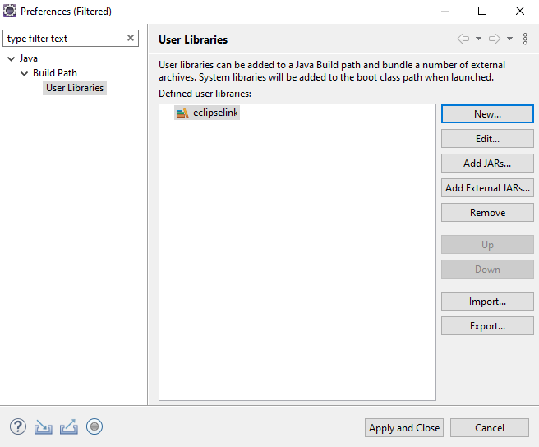
How to add Project Facets
Click on Add External Jars…

Slide 35
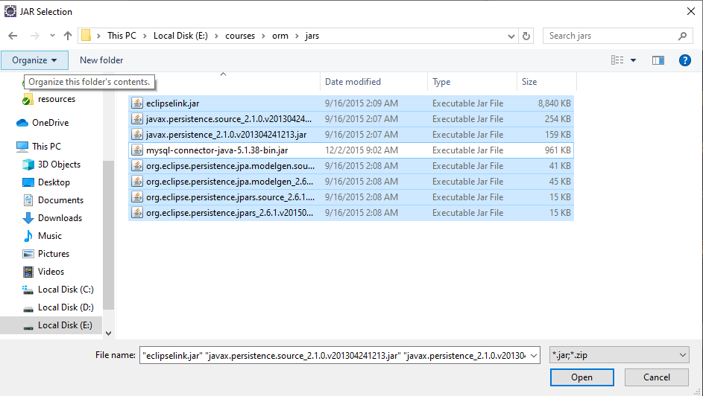
How to add Project Facets
Chose the following Jars and click on Open button.

Slide 36
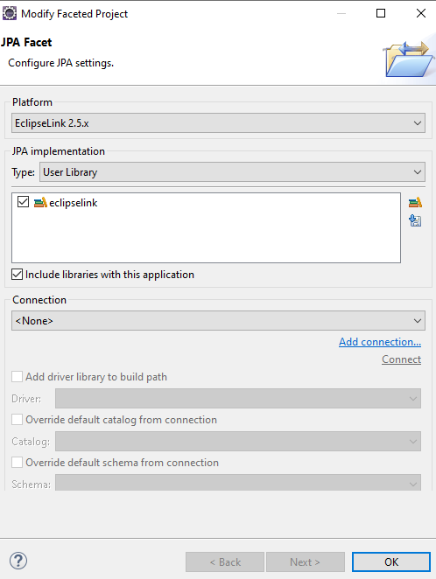
How to add Project Facets
Check the eclipselink library and click on Add connection…

Slide 37
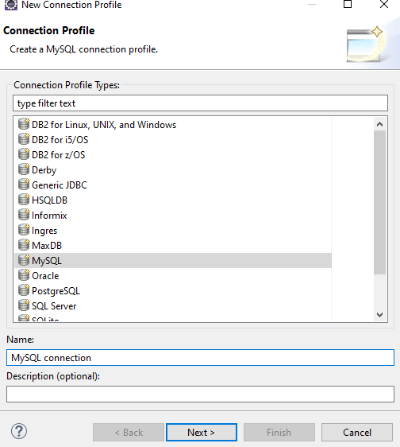
How to add Project Facets
Chose MySQL and then click on Next button.

Slide 38
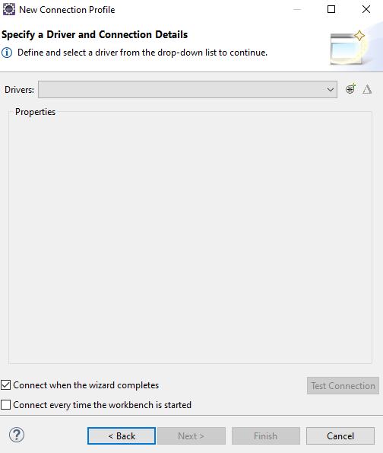
How to add Project Facets
Click on +

Slide 39
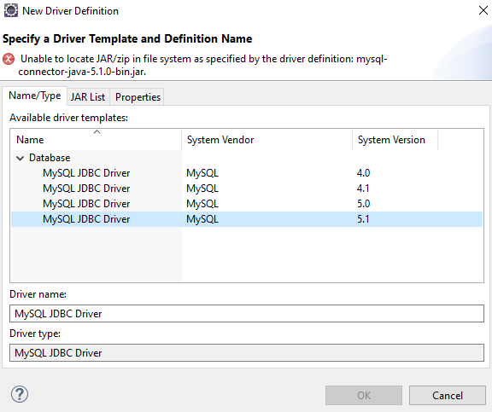
How to add Project Facets
Chose MySQL 5.1.

Slide 40
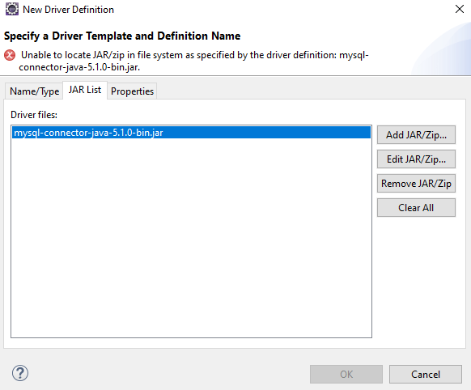
How to add Project Facets
Remove the mysql connector jar.

Slide 41
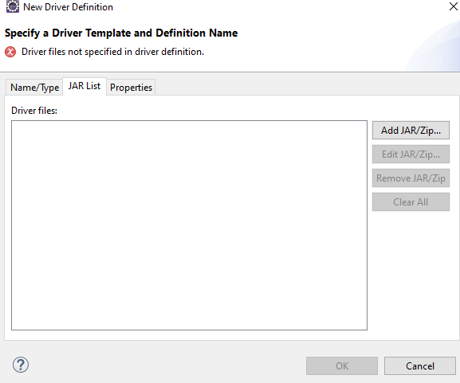
How to add Project Facets
Click on Add JAR/ZIP…

Slide 42
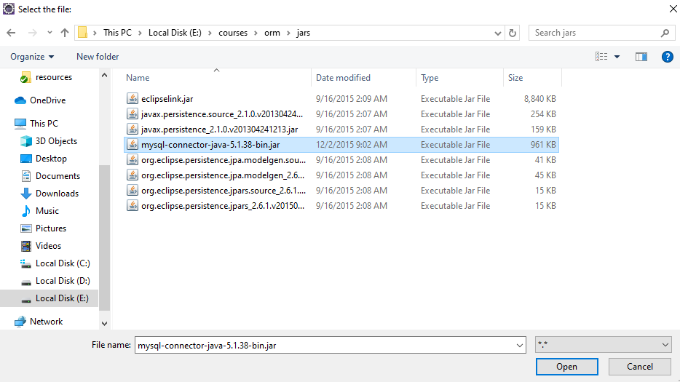
How to add Project Facets
Chose the mysql connector 5 jar and click on Open button.

Slide 43
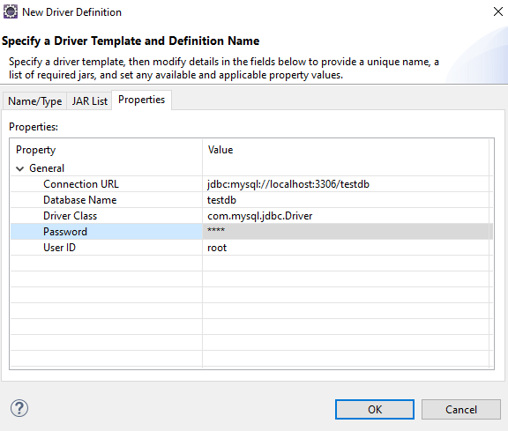
How to add Project Facets
Click on Properties tab, then add your database name and your user id and password of the your sql server.

Slide 44
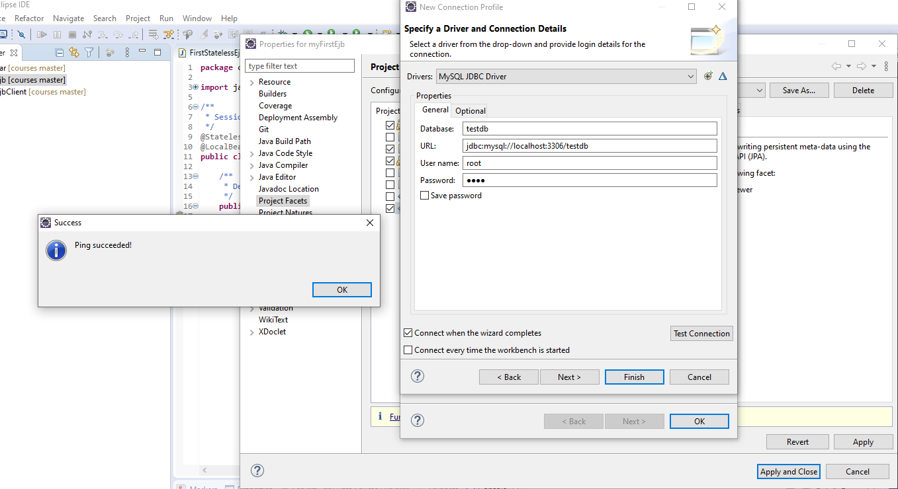
How to add Project Facets
Click on Test Connection. If everything is ok you should receive the following message:

Slide 45
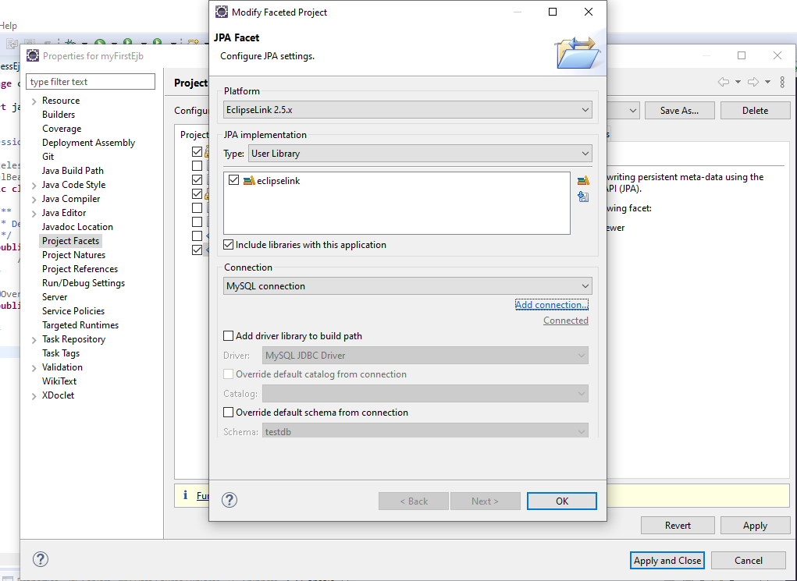
How to add Project Facets
Click on OK button, then on Apply and on Apply and Close.

Slide 46
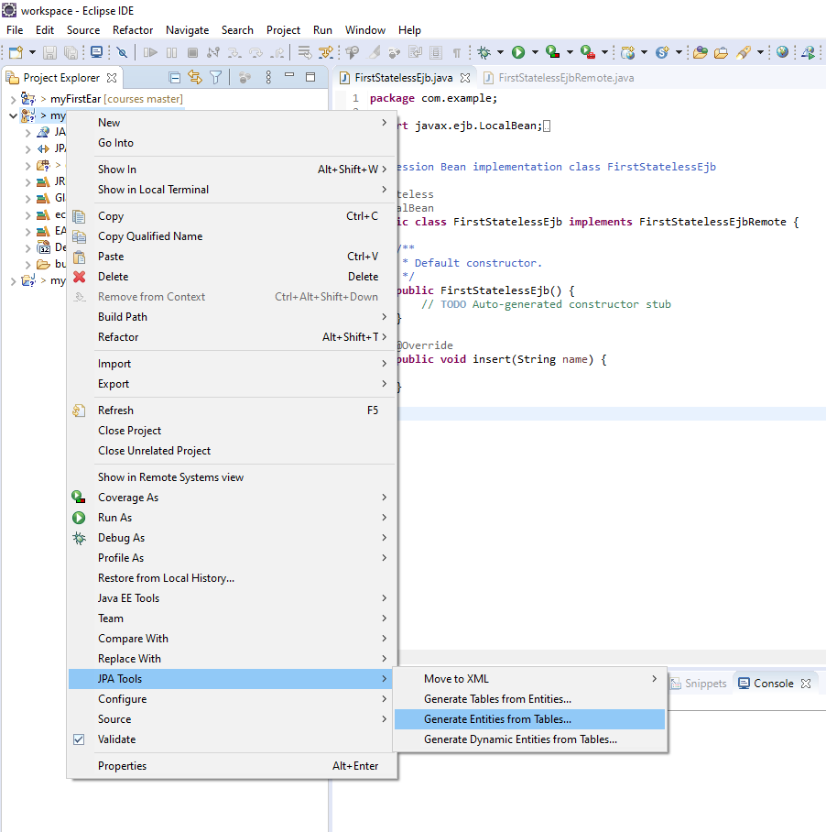
How to generate JPA entities
Right click on your EJB project, then click on Generate Entities from Tables.

Slide 47

How to generate JPA entities
Chose your connection and your schema.

Slide 48

How to generate JPA entities
Chose Identity, then click on Finish button.

Slide 49

How to generate JPA entities
If everything is ok you should see a persistence.xml file and the classes generated that map with your tables from your database.

Slide 50

How to configure Glassfish
After you started the server from Eclipse, open a browser at localhost:4848. You should see something like this:

Slide 51

How to configure Glassfish
Click on JDBC Connection Pools, then click on New.

Slide 52

How to configure Glassfish
Add a Pool Name, chose javax.sql.ConnectorPoolDataSource as resource type, then chose MySql as vendor. Click on Next Button.

Slide 53
How to configure Glassfish
Fill these properties according to your set up.

Slide 54

How to configure Glassfish
Click on Finish button.

Slide 55
How to configure Glassfish
Click on your connection pool.

Slide 56

How to configure Glassfish
Click on Ping button.

Slide 57

How to configure Glassfish
If everything is ok you should see a message like this:
In case of any errors check the properties again.

Slide 58

How to configure Glassfish
Click on JDBC Resources, then click on New

Slide 59

How to configure Glassfish
Add a JNDI Name, then click on OK button.

Slide 60

How to configure Glassfish
Restart the server

Slide 61

How to configure Glassfish
Click on persistence.xml and add your jdbc resource name that was configured in glassfish previously. Press ctrl+s.

Slide 62

How to configure Glassfish
If you click on Source you should see your resource name.

Slide 63


How to create a Standalone app
Click on New -> Others… -> Java Project -> Next

Slide 64

How to create a Standalone app
Add a project name, then click on Finish button.

Slide 65


How to create a Standalone app
Right Click on the standalone project. Click on Properties -> Java Build Path -> Libraries -> Add External JARs…

Slide 66

How to create a Standalone app
Select appserv-rt.jar and gf-client.jar and click on Open button.

Slide 67

How to create a Standalone app
Click on Projects tab

Slide 68

How to create a Standalone app
Click on Add button.

Slide 69

How to create a Standalone app
Select your EJB client project, then click on OK -> Apply -> Apply and Close

Slide 70

How to create a Standalone app
Add a constructor in the entity class

Slide 71

How to create a Standalone app
Add an insert method in the FirstStatelessEjb class.

Slide 72


How to create a Standalone app
After you restarted the server you should see something like this:

Slide 73

How to create a Standalone app
Create a Main Class like this and add your JNDI name.

Slide 74

How to create a Standalone app
Run the project as Java Application

Slide 75

How to create a Standalone app
If everything is ok you should see something like this in your database.

